Slide 1
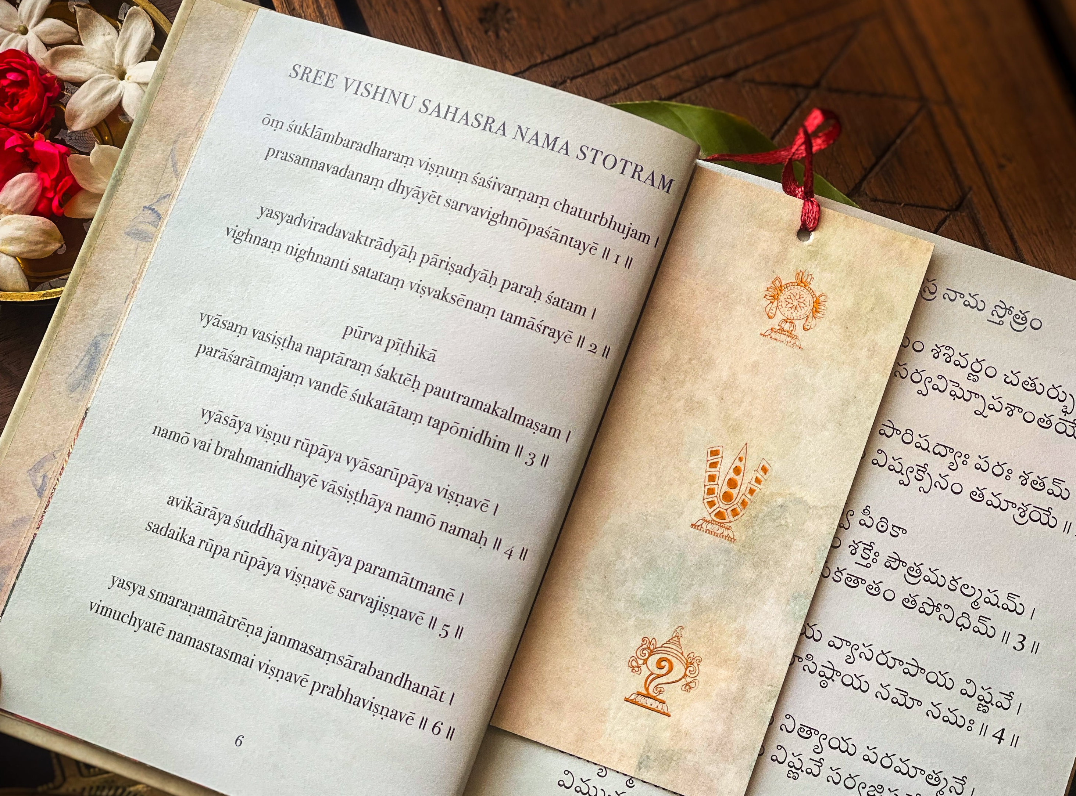
Nirukti - Viṣṇu Sahasranāma
A Sanskrit word-analysis system with NLP integration
Mukunda Hari

Slide 2
Project Overview
Computational analysis of the thousand names of Lord Vishnu
Bridge between ancient Sanskrit linguistics and modern technology
Interactive system using Natural Language Processing (NLP)
Educational tool for Sanskrit students and enthusiasts
Foundation for broader Sanskrit computational analysis

Slide 3
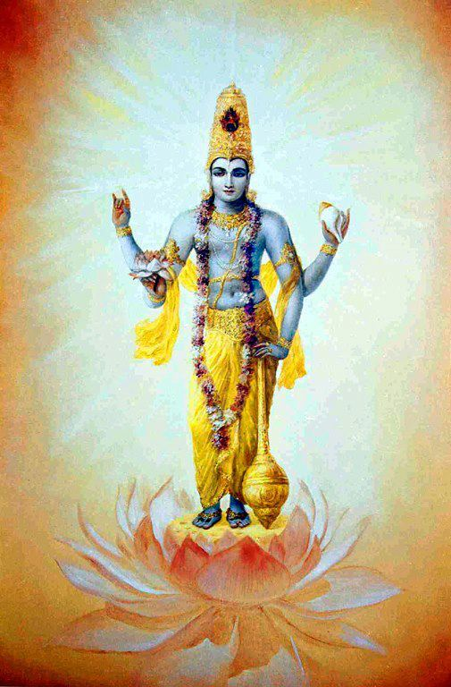
What is Vishnu Sahasranāma?
Understanding Vishnu Sahasranāma
Collection of 1000 predominant names of Bhagavān Viṣṇu
Found in the Anuśasana Parva of the Mahābhārata
Each name describes different qualities of Nārāyaṇa
A prominent text in Vaiṣṇavism and is chanted daily

Slide 4
Project Objectives
Develop a functional Sanskrit name analyzer
Create modular Python-based system with grammatical breakdowns
Implement NLP-powered conversational interface
Demonstrate computational methods in Sanskrit linguistics
Establish foundation for future expansion
Create accessible educational tool

Slide 5
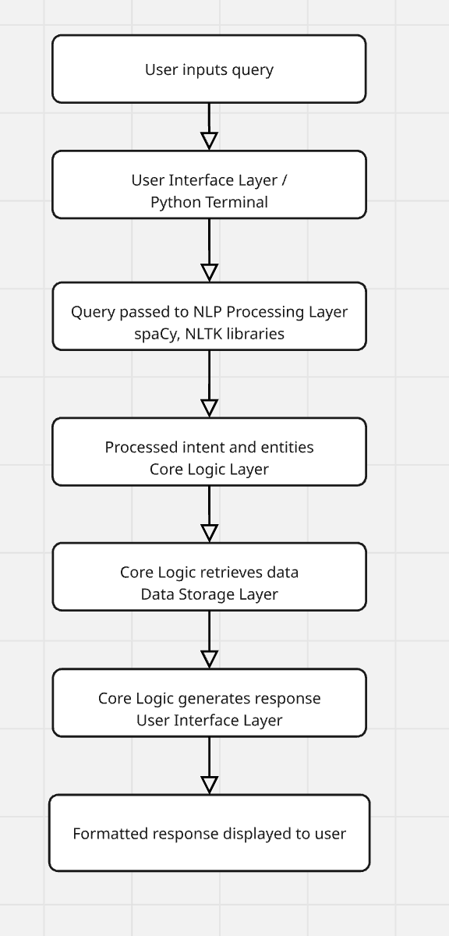
System Architecture
Python-based core system
JSON data storage for names and analysis
NLP processing using spaCy and NLTK
Conversational interface for natural language queries
Terminal-based UI (with future GUI possibilities using frameworks)

Slide 6
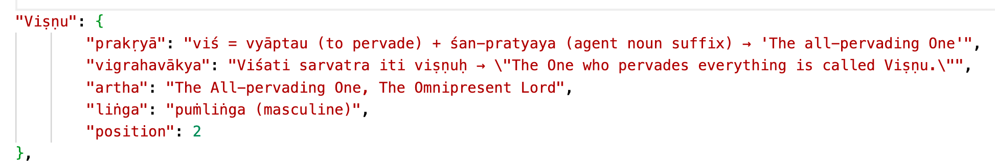
Data Structure
Sanskrit Linguistic Data Structure
Each name contains:
IAST standard for accurate transliteration
Structured to enable computational analysis

Slide 7
NLP Components & Features
Natural Language Processing and it’s capabilities
Transforming a dictionary lookup into an intelligent conversational system
Query Understanding: Interpreting natural language questions
Semantic Search: Finding names based on concepts
Fuzzy Matching: Handling spelling variations
Context Awareness: Maintaining conversation flow
Natural Language Responses: Generating appropriate answers

Slide 8
Technical Implementation
Python programming language
spaCy for linguistic processing
Custom algorithms for Sanskrit terminology
Meaning-to-name mapping for concept searching
GitHub for version control

Slide 9
Example Interactions
Examples of how users can interact with the system:
"What does Vishnu mean?"
"Tell me about names related to creation"
"Show me the grammatical breakdown of Paramātmā"
"What is the etymology of Keśavaḥ?"
"Which names refer to protection?”

Slide 10
Future Enhancements
Web-based interface using Streamlit
Expansion to other Sanskrit texts
Advanced machine learning for pattern recognition
Etymology tree visualizations
Mobile application development
Voice interface for questions and answers

Slide 11
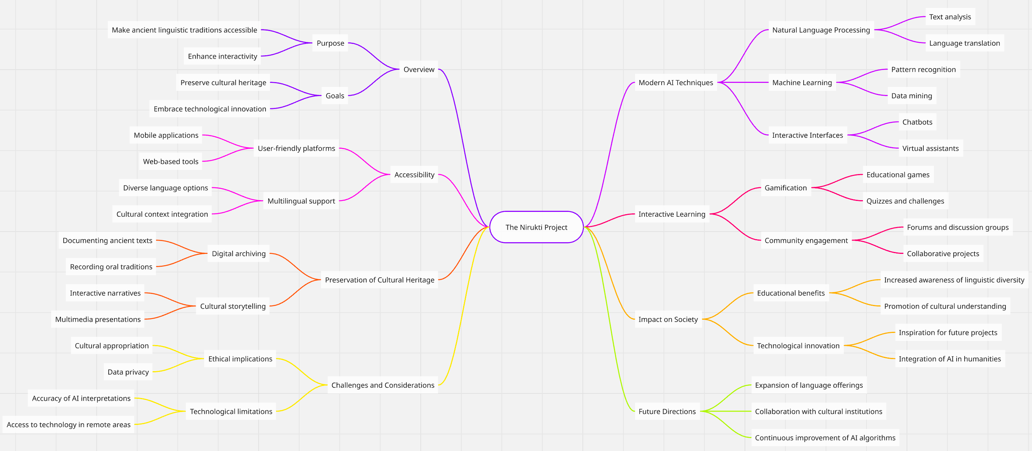
Conclusion
The Nirukti project demonstrates how modern AI techniques can make ancient linguistic traditions more accessible and interactive, preserving cultural heritage while embracing technological innovation.

Slide 12
Thank You
Mukunda Hari
6th Sem,
BCA,
BMSCCM

